Slide 1




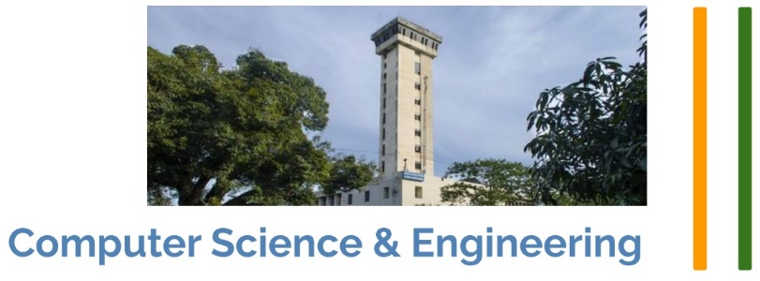
Thapar Summer School 2022 | Day 27
‘Explainable AI’
Introduction and Hands-on Practices
Puneet Kumar
puneet-kr.github.io
Research Scholar
Machine Intelligence Lab, CSE Dept., IIT Roorkee
Founding Director & CTO
PaiByTwo Private Limited

Slide 2
About the Speaker
Founding Director and CTO, PaiByTwo Pvt. Ltd. [2021+]
Visiting Researcher, Osaka Prefecture University, Osaka, Japan [2019]
Visiting Researcher, Samsung R & D, Delhi, India [2018-19]
Software Engineer, Oracle IDC, Hyderabad, India [2014-16]
Ph.D., IIT Roorkee, Uttarakhand [2018-22]
M.E. (CSE), TIET Patiala, Punjab [2016-18]
B.E. (CSE), MIT Manipal, Karnataka [2010-14]
Areas of Research
Affective Computing and Cognitive Science
Multimodal Intangible Emotion Analysis
Machine Learning and Deep Learning
Explainable Artificial Intelligence
Meta-heuristic Optimization

Slide 3
Outline
1. Explainability
2. Interpretability
3. SHAP
4. LIME
1. Intro, SHAP, LIME
1. SHAP
2. LIME
3. Interaction
2. Hands-on
1. Cluster-based Explainability
2. Transfer Learning recap
3. Hands-on
3. Cluster based…
1. Extend Shap/LIME
2. DnCShap
3. Research papers
4. Resources
5. Q/A
4. Research…
Notes:
-> Learning outcomes:+=
-> How to decide a problem statement!
3

Slide 4
Explainability
Interpretability
Introduction
Fairness
Trustworthy AI
Reliability
Notes:
Relationship with DL models..
Trust in relationships..
Research paper by Ribiero et al (2016) titled “Why Should I Trust You” aptly encapsulates the issue with ML black boxes.
4

Slide 5
Explainability & Interpretability [1]
Explainability:
Describe a model's mechanism that led to a particular output.
How did we reach a particular output?
Interpretability:
Understand the context of a model's output, analyzes its functional design, and relate the design to the output.
What made us reach a particular output?
Cause-effect relationship. ‘What’ was the cause of the output effect?
Notes:
-> Both the terms are useinterchangeablyly. ‘Explainable’ is more often used. These definitions: NIST (who released MNIST dataset).
-> https://www.bmc.com/blogs/machine-learning-interpretability-vs-explainability/
-> Local vs Global Interpretability: In linear regression models, Beta coefficients explain the prediction for all the data points (if variable value increases by 1, prediction increases by Beta for every data point). This is global fidelity. In a causal analysis, it is called “average” causal analysis.
5

Slide 6
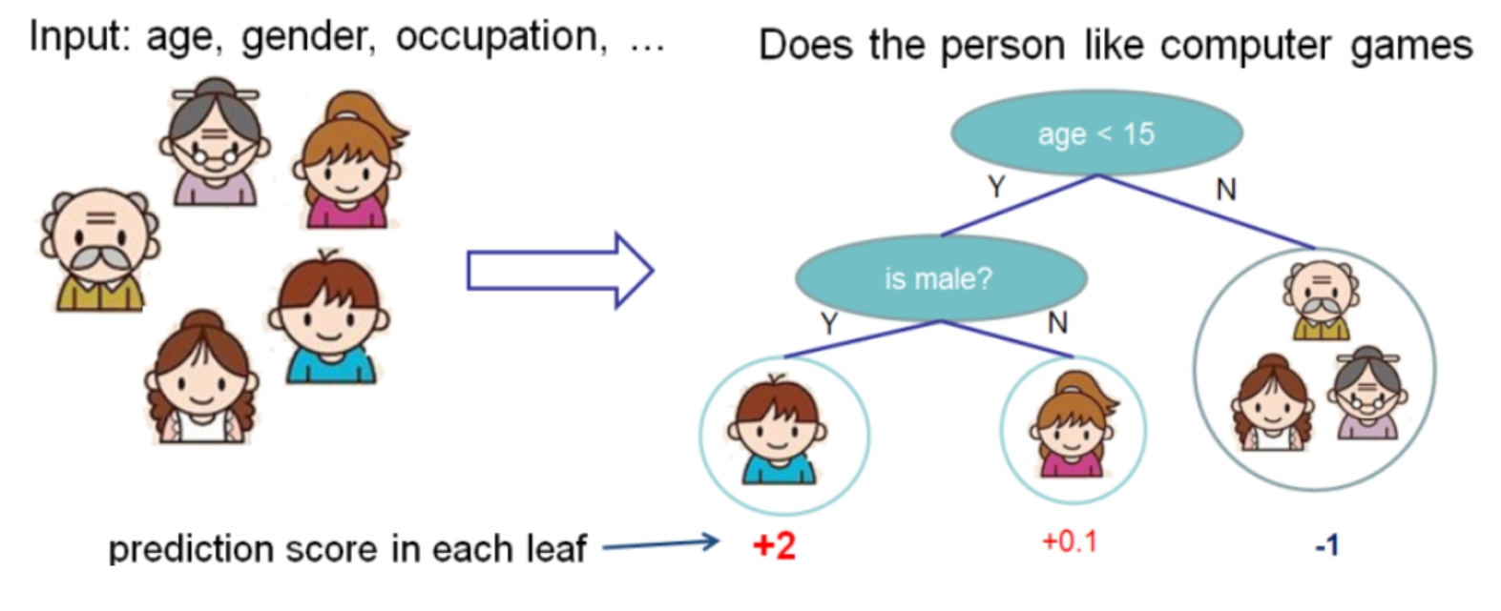
Local & Global Explainability
Figure 1: Local & Global Explainability
Notes:
At the global level: how many splits (will give us some insights); At the local level: age.
6

Slide 7
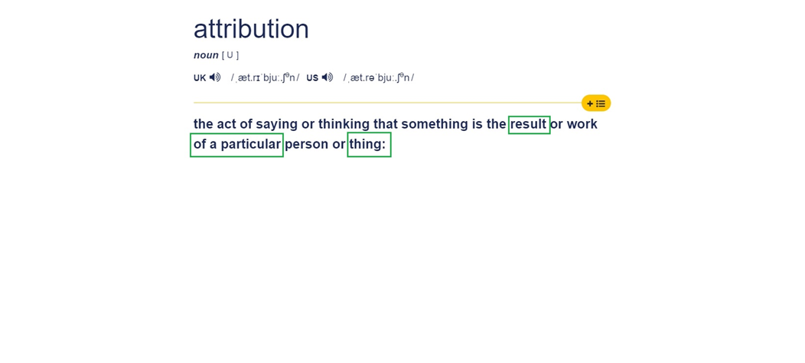
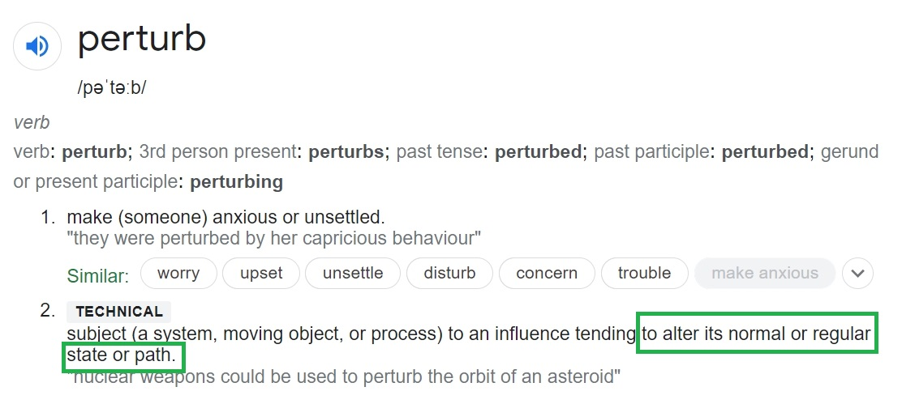
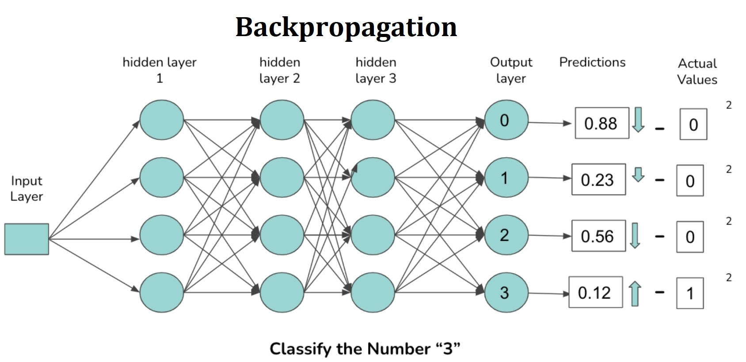
Explainable AI Approaches
Explainable AI approaches:
Attribution-based approaches, such as SHAP [2] assign a relevance or importance score to each input feature based on Shapely values [3].
Perturbation-based approaches, such as LIME [4] compute the importance score by slightly changing the input.
Backpropagation-based approaches, such as ‘Saliency Map’ [6] and Grad-CAM [5] calculate the attributions by back-propagating through the network.
Explainable AI approaches:
Attribution-based approaches, such as SHAP [2] assign a relevance or importance score to each input feature based on Shapely values [3].
Perturbation-based approaches, such as LIME [4] compute the importance score by slightly changing the input.
Backpropagation-based approaches, such as ‘Saliency Map’ [6] and Grad-CAM [5] calculate the attributions by back-propagating through the network.
Notes:
https://www.bmc.com/blogs/machine-learning-interpretability-vs-explainability/
Local vs Global Interpretability: In linear regression models, Beta coefficients explain the prediction for all the data points (if variable value increases by 1, prediction increases by Beta for every data point). This is global fidelity. In a causal analysis, it is called “average” causal analysis.
7

Slide 8
Popular Explainability Models
Notes:
LIME and SHAP are surrogate models (Figure 1). It means they still use the black-box machine learning models. They tweak the input slightly (like we do in sensitivity tests) and test the changes in prediction... This tweak has to be small so that it is still close to the original data point (or in the local region)... Since surrogate models still treat the ML models as a black box, these are model agnostic.
8

Slide 9
Popular Explainability Models
Popular Explainability models
SHAP: Attribution based.
LIME: Perturbation based.
Grad-CAM: Back-propagation based. [self-study]
These are Surrogate Models.
They still use the black-box machine learning models.
They tweak the input slightly and test the changes in prediction.
This tweak has to be small so that it is still close to the original data.
Notes:
Surrogate: substitute.
Since surrogate models still treat the ML models as a black box, these are model agnostic.
9

Slide 10
SHAP
‘SHapley Additive exPlanations.’
Attribution based Explainability approach.
Based on Game Theory (reward proportional to contribution).
Break (virtually) the core complex model into many simple models. Find Shapely values example-by-example.
Then Aggregate and Explain the overall model.
Notes:
A data point has to be converted into a format that is easier to work with for building surrogate models (sampling data points in the neighborhood of the original data point). This representation is called interpretable (in the LIME paper) as it is understandable to humans … An important question in the field of machine learning is why an algorithm made a certain decision… As an end user, I am more likely to trust a recommendation if I understand why it was exposed to me. ("As an organization, understanding that customers made a purchase because this campaign was particularly effective can allow me to tailor my future outreach efforts.")
10

Slide 11
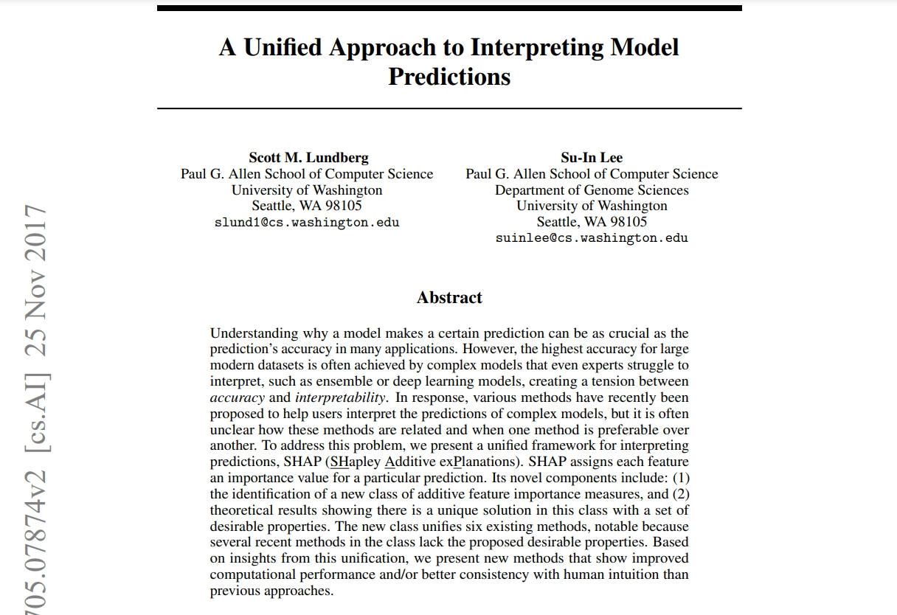
SHAP
Notes:
11

Slide 12
Why bother explaining ?
Simple linear regression model (coefficient Ø for feature x)
It can discover linear relationships. It is explainable.
Non-linear relationships <= complex models, difficult to explain.
What do we want?
To be able to use complex models.
Learn non-linear relationships in the data.
To be able to interpret them as well.
Notes:
Linear regression: simple, very explainable (larger phi => more explainable). this model is so simple that it can only uncover linear relationships.
For instance, maybe age is an important feature, and if you’re between 12 and 18, you’re much more likely to like computer games than at any other age; since this is a non-linear relationship, a linear regression wouldn’t be able to uncover it. In order to uncover this more complicated relationship, I’ll need a more complicated model.
non-linear, or even interwoven relationships — e.g. what if age is important depending on your gender? — then it becomes very tricky to interpret
12

Slide 13
How to (start) explaining ?
One (linear regression) model: explain one example.
Many linear regression models: explain all the examples.
Rephrasing:
“Take a complex model, which has learnt non-linear patterns in the data, and broken it down into lots of linear models which describe individual data points.”
This is how SHAP does it ! [More details: upcoming slides.]
Idea: Breaking into parts | Complexity | Divide & Conquer.
Hint: This is one way to develop novel research ideas.
Notes:
Let’s discuss more about complexity.
13

Slide 14

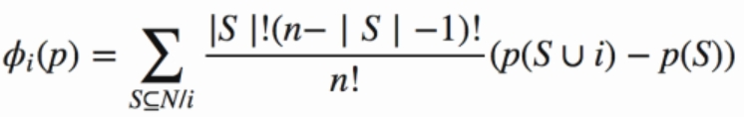
Shapely Values
To explain how the complex model behaved for just one data point.
Aggregate it to get an idea of how my model worked globally.
Assume a linear explanation model, g
Shapley value, ϕ denotes the importance of a particular feature.
ϕ_{i}(p) for a certain feature i (out of n total features), given a prediction p (by the complex model) is given as follows, where S denotes a set.
Notes:
S range to all the sets N, except the ones containing i.. Let’s elaborate more on what’s happening here…
Eye: Beauty of Machine Learning, how it embodies the concepts of life and science.
From game theory.
Suppose a team of 11 got a reward. Shouldn’t it be divided equally? Yes, right? That’s the foundation of Shapley values.
These are fairly intuitive rules to have when dividing a reward, and they translate nicely to the machine learning problem we are trying to solve. In a machine learning problem, the reward is the final prediction of the complex model, and the participants in the game are features.
Lloyd Shapley introduced this method in 1953 (which is why values of ϕ calculated in this way are known as Shapley values). The Shapley value for a certain feature i (out of n total features), given a prediction p (this is the prediction by the complex model) is
14

Slide 15

Shapley values: Elaboration
Shapely value: inherited from Game Theory [3].
Core Idea: Contribution ∝ Reward.
Shapley values: calculate the importance of a feature by comparing what a model predicts with and without the feature.
Calculate what the prediction of the model would be without feature i,
Calculate the prediction of the model with feature i,
Calculate the difference => importance of feature i.
Example calculations of ϕ : SHAP base paper [2] and blog [7].
Notes:
what this equation does is calculate what the prediction of the model would be without feature i, calculate the prediction of the model with feature i, and then calculate the difference.
However, since the order in which a model sees features can affect its predictions, this is done in every possible order, so that the features are fairly compared.
15

Slide 16
LIME
‘Local Interpretable Model-agnostic Explanations.’
Purturbation based Explainability approach.
Algorithm to explain any *black-box algorithm by making Local approximations.
It doesn’t know the internals of the blak-box => Model-agnostic.
Core idea: zoom into the local area of the individual prediction
=> make a simple explanation in that local region.
*Most complex models are complete black-boxes and their internal mechanisms are hidden.
Notes:
The basic idea of LIME is that we zoom into the local area of the individual prediction. We can make a simple explanation (why that prediction was made) in that local region => Local.
16

Slide 17
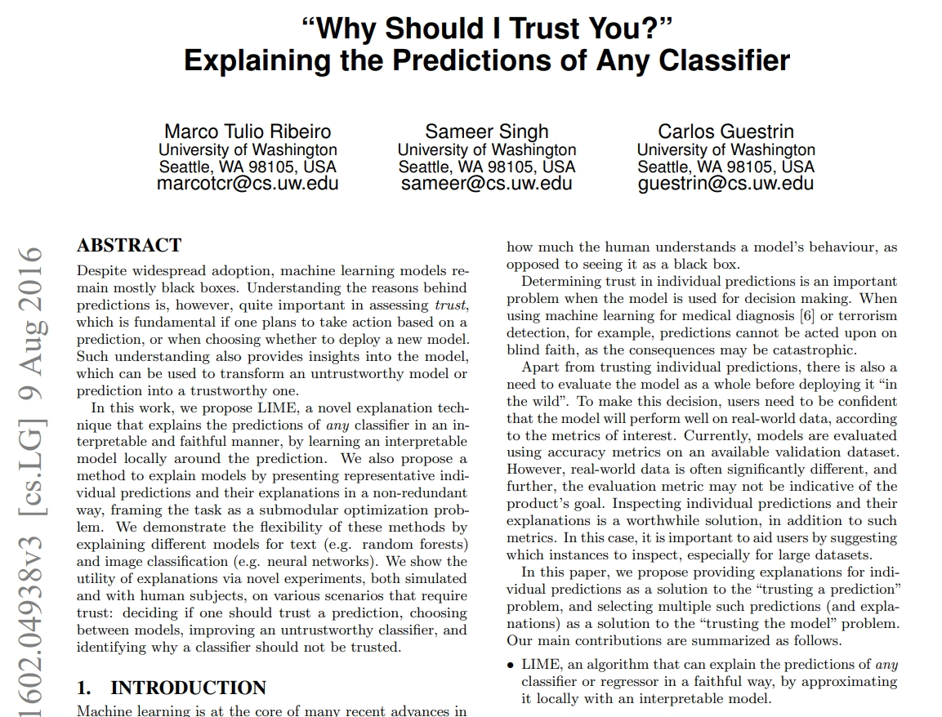
LIME
Notes:
17

Slide 18
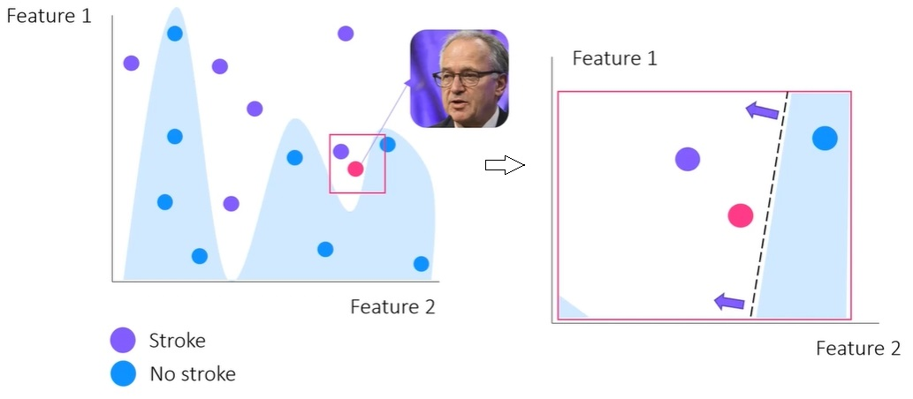
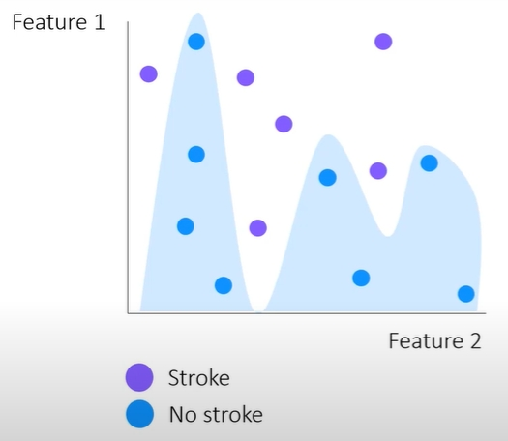
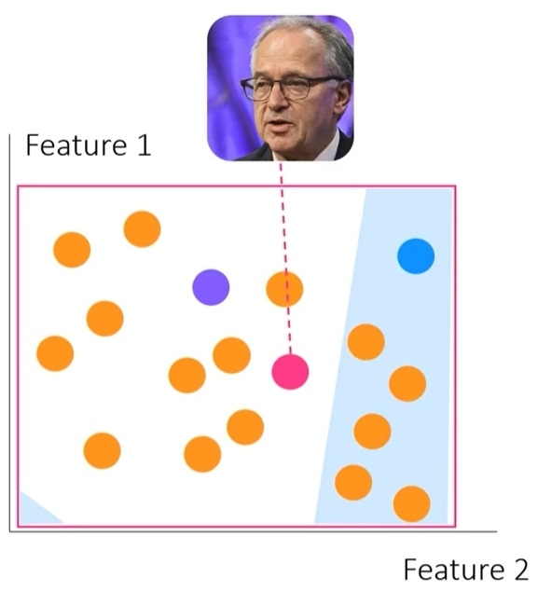
LIME: Core Idea
Figure 2: Code Idea of LIME
Notes:
Let’s assume a complex model to classify stroke/no-stroke. The predictions we make are non-linear, i.e., it’s there is no easy to explain relationship about how the model makes the predictions. We can not summarize the whole decision boundary into one explanation.
Points near to the target point: more weight/importance.
18

Slide 19
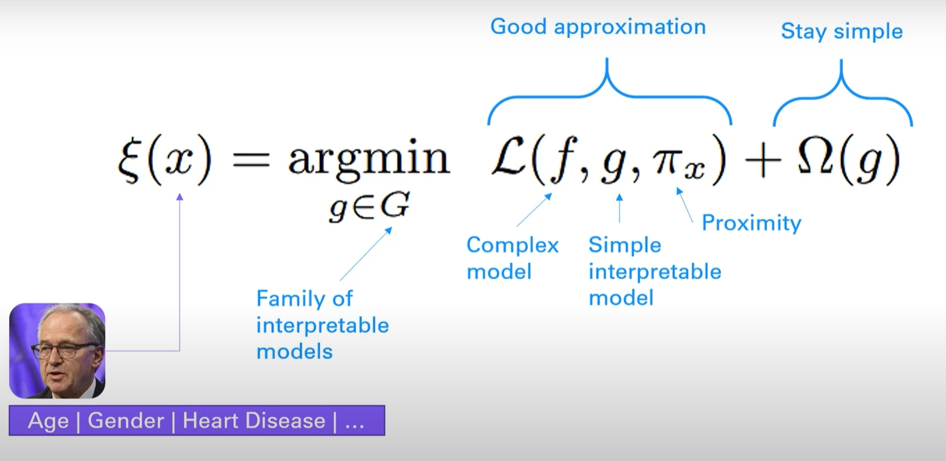
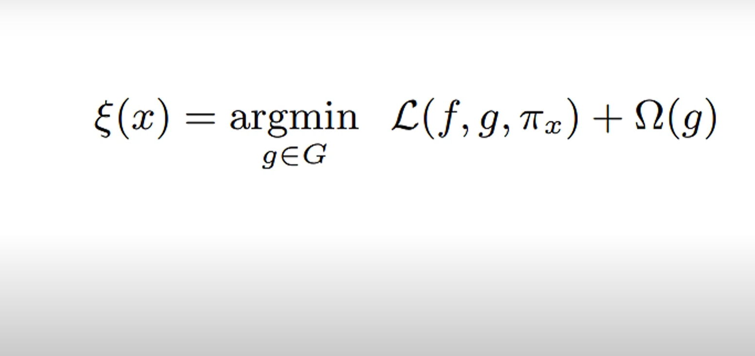
LIME: The Maths
Local approximation of our complex model for a specific input.
Figure 3: The mathematics behind LIME
Notes:
L: Loss; Pai: proximity; Omega: complexity
G: surrogate model
19

Slide 20
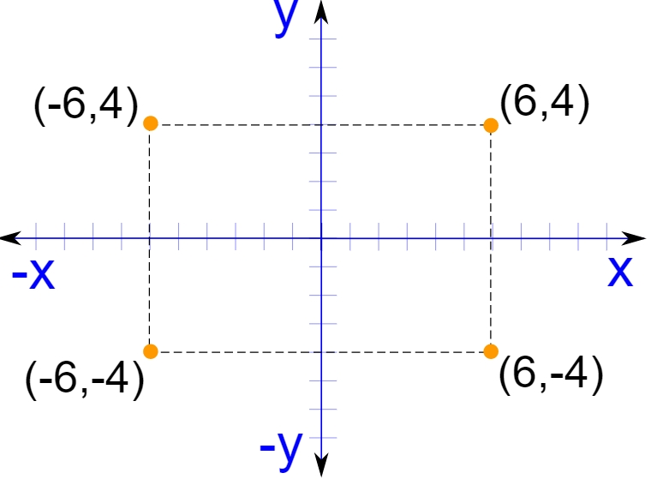
LIME: Elaboration
Purturb (e.g. add/remove/transform some binary dimensions).
=> generate new data in the proximity of the target data sample.
Feed the purturbed data to the black-box model.
Observe the changes in the outputs => make sense of it => explain.
Figure 4: Purturbation’s example
Notes:
L: Loss; Pai: proximity; Omega: complexity
20

Slide 21
Hands-on
Ref: https://github.com/puneet-kr/TSS2022D27
Notes:
21

Slide 22
Hands-on: LIME
☑ Import libraries, setup the model and load the data
☑ Install LIME (pip install lime)
☑ NLP Pre-processing
☑ Split train-test data and create the model
Note: Perturbation using scikit-learn's make_pipeline algorithm that vectorizes and transforms the data
☑ Create Model Explainer (LIME_explainer)
☑ Explain using LIME_explainer
Notes:
Data Loader
Import metrics
Model: RF, that will serve as the blackbox model.
Perturbed data [ToDo]
explain_local() fit a local model…
Interpretation (which feature has negative impact and which has positive)
More examples [from other implementations]
22

Slide 23
Hands-on: SHAP
☑ Import libraries, setup the model and load the data
☑ Install SHAP (pip install shap)
☑ Pre-processing
☑ Split train-test data and create the model
☑ Create SHAP_explainer and calculate the shap values
Note: Attribution/perturbation using scikit-learn's make_pipeline algorithm that vectorizes and transforms the data
☑ Interpret Global Feature Importance
☑ Interpret Local Feature Importance
Notes:
23

Slide 24
Cluster based Explainability
Notes:
24

Slide 25
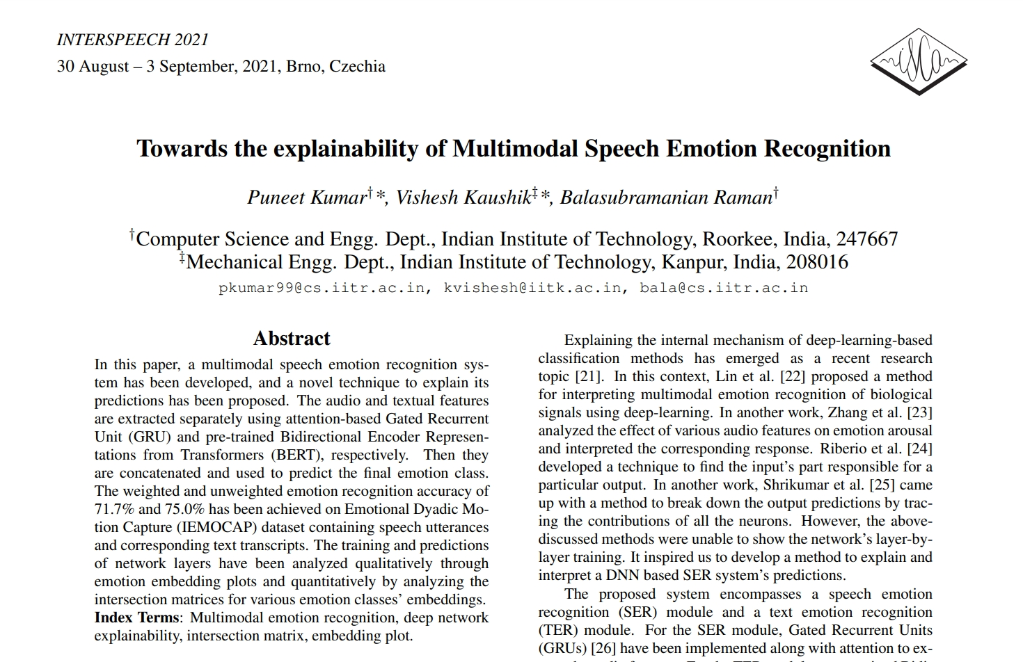
Cluster based Explainability
Notes:
Cite InterSpeech paper…Github link for full implementation…
The architecture of the proposed system is depicted in Fig. 1. Speech Emotion Recognition (SER) → Gated Recurrent Units + Attention. Text Emotion Recognition (TER) → pre-trained Bidirectional Encoder Representations from Transformers (BERT). The audio & text features are concatenated & used for emotion recognition.
25

Slide 26
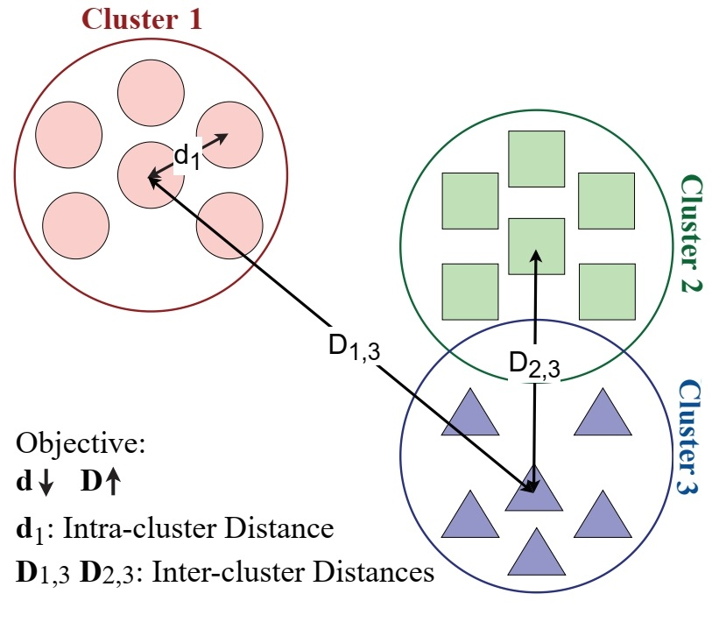
Cluster based Explainability
Figure 5: Core hypothesis of Cluster-based Explainability
Notes:
Vs T-SNE Embeddings (more Explainability)
Vs Clustering.
26

Slide 27
Cluster based Explainability
Proposed Explainability technique [9] to explain the trained model’s predictions:
➵ Compute principal components (x_{i}, y_{i}, z_{i}) of the last layer’s embedding for class i.
➵ For class i and (x_{i}, y_{i}, z_{i}) components, compute mean m_{i} and standard deviation σ_{m¯i}.
➵ For i^{th} class’s m^{th} component’s spread, compute the range for i^{th} motion with left extreme point L_{i}(m) and right extreme point R_{i}(m).
➵ The intersection between classes i and j, i.e., I_{i,j}(m) is computed as the intersection between the spread of the m^{th} component’s data for classes i and j.
➵ The total intersection between classes i and j, i.e., I_{i,j} is calculated as the product of component-wise intersections I_{i,j}(x) ∗ I_{i,j}(y) ∗ I_{i,j}(z).
➵ The (i, j)^{th} element of the Intersection Matrix I of size c × c, represents the total intersection I_{i,j} between the emotion classes i & j where c denotes total no. of classes.
Notes:
27

Slide 28
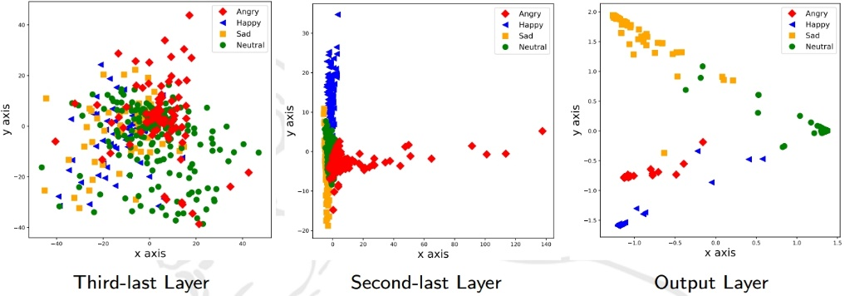
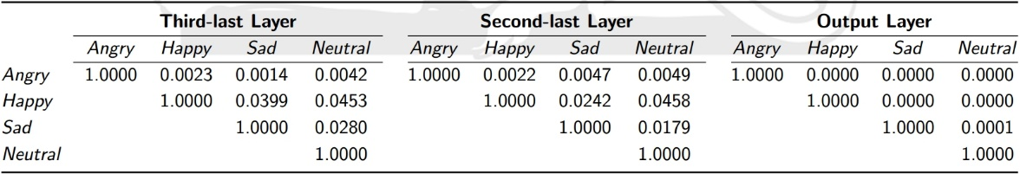
Cluster based Explainability
Figure 6: Emotion embedding plots for various layers
Table 1: Intersection matrices for the proposed model.
Notes:
Explainability/Interpretation: The Intersection matrix has been used to explain the emotion classification mechanism of the proposed method. The clusters of the same emotions should overlap, and those for different emotions should be separated. The value of one for the diagonal elements and convergence of non-diagonal elements’ values to zero validates this hypothesis. Inter-emotion clusters’ separability improves from intermediate to output layers. The decrease in non-diagonal elements’ values in the intersection matrix affirms that the model has learned to classify various emotions
28

Slide 29
Hands-on
Ref: https://github.com/puneet-kr/TSS2022D27
Notes:
29

Slide 30
Hands-on: Cluster based Explainability
☑ Import Libraries
☑ Create Transfer Learning pipeline (or setup a new model)
☑ [ToDo]: Add/reduce more layers and observe the clusters
☑ Setup Data Generators
☑ Define step-size and for the model
☑ Cluster plot implementation
☑ Model Summary
☑ [ToDo] Cluster plots for various layers
▢ Intersection Matrix: Ref. https://github.com/MIntelligence-Group/SpeechImg_EmoRec
Notes:
30

Slide 31
Explainable AI Research
Notes:
31

Slide 32
DnCSHAP [10]
‘Divide and Conquer based SHapley Additive exPlanations.’
Computes the approximated Shapley values for the input images in linear time instead of the exponential.
Divide and Conquer => continuously divide the input image into two parts. Find Shapely values. Aggregate.
Identifies the highly relevant parts of the input that contribute the most to recognizing the emotion classes.
Notes:
32

Slide 33
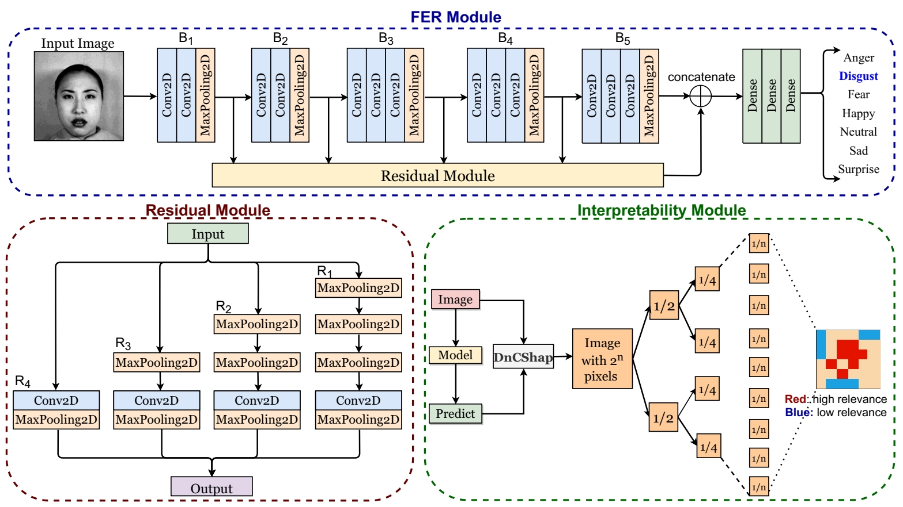
Explainable Facial Emotion Recognition
Figure 7: Extension of SHAP model to interpret facial emotion recognition
Notes:
33

Slide 34
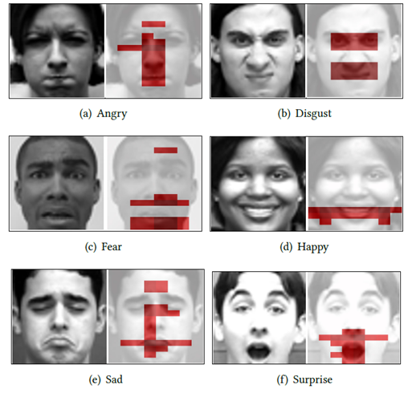
Explainable Facial Emotion Recognition
Figure 8: Results of DnCSHAP for facial emotion recognition
Notes:
34

Slide 35
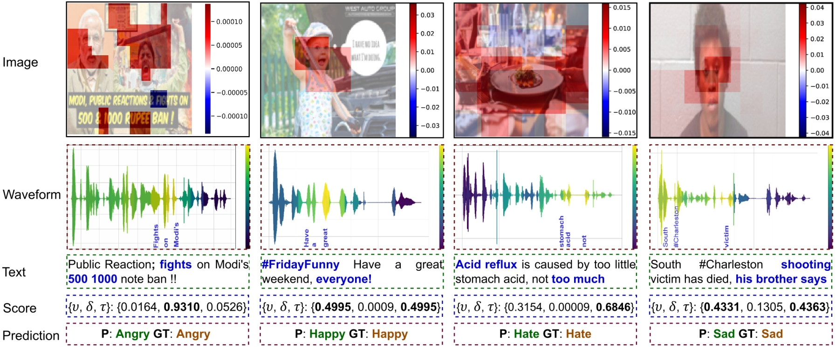
Explainable Multimodal Emotion Recognition*
Figure 9: Results of DnCShap for multimodal emotion recognition
*Under review work. Ref: https://github.com/MIntelligence-Group/SpeechImg_EmoRec
Notes:
35

Slide 36

Resources
Notes:
36

Slide 37
Papers, Tutorials, Blogs & Talks
SHAP Paper
SHAP Documentation
SHAP Implementation
SHAP Results’ Analysis
LIME Paper
LIME Documentation
LIME Implementation (inc. Results’ Analysis)
Blog: Interpretable ML
Book: Interpretable ML
Talk: building Explainable ML Systems: The Good, Bad, and Ugly
Tutorials: Explainable AI | Playlist (DeepFindr)
Notes:
37

Slide 38
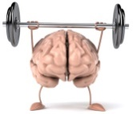
Advanced Concepts
Grad-CAM : Selvaraju, R., Cogswell, M., Das, A., Vedantam, R., Parikh, D., & Batra, D. Grad-CAM: Visual Explanations from Deep Networks via Gradient-based Localization. CVPR 2017 (pp. 618-626).
DnCSHAP: Malik, S., Kumar, P. and Raman, B., Towards Interpretable Facial Emotion Recognition. ICVGIP 2021 (pp. 1-9).
Multimodal Interpretability Example: github.com/MIntelligence-Group/SpeechImg_EmoRec
Notes:
38

Slide 39
Key References
David A Broniatowski et al. Psychological Foundations of Explainability and Interpretability in Artificial Intelligence. National Institute of Standards and Technology (NIST), 2021
Scott M Lundberg and Su-In Lee. 2017. A Unified Approach to Interpreting Model Predictions. In The 31st International Conference on Neural Information Processing Systems (NeuroIPS). 4768–4777.
LS Shapley. 1953. A Value for n-person Games, Contributions to the Theory of Games II, AW Tucker, HW Kuhn.
Marco Ribeiro et al. 2016. "Why Should I Trust You?" Explaining the Predictions of Any Classifier. In The 22nd ACM SIGKDD International Conference on Knowledge Discovery and Data Mining (KDD). 1135–1144.
Ramprasaath Selvaraju et al. 2017. Grad-CAM: Visual Explanations from Deep Networks via Gradient-based Localization.
Karen Simonyan, Andrea Vedaldi, and Andrew Zisserman. 2013. Deep Inside Convolutional Networks: Visualising Image Classification Models and Saliency Maps. arXiv preprint arXiv:1312.6034 (2013).
https://medium.com/@gabrieltseng/interpreting-complex-models-with-shap-values-1c187db6ec83
https://towardsdatascience.com/understanding-model-predictions-with-lime-a582fdff3a3b
Kumar, P., Kaushik, V., & Raman, B.. Towards the Explainability of Multimodal Speech Emotion Recognition. Interspeech (pp. 1748-1752).
Malik, S., Kumar, P. and Raman, B., Towards Interpretable Facial Emotion Recognition. ICVGIP 2021 (pp. 1-9).
Notes:
39

Slide 40
Thank you
puneet-kr.github.io
pkumar99@cs.iitr.ac.in
classroom@paibytwo.com

